Slide 1

Online Sales Analysis
Understanding business performance, customer behavior, and revenue trends.

Slide 2

Project Overview
Goal
Focus
Analyze online sales dataset.
Identify top products, regions, categories.
Method
Utilize data analytics techniques.

Slide 3

Dataset Summary
online_sales.csv
10,000 Rows (transactions)
9 Columns
Key Columns
Details
transaction_id
product_name
date
units_sold
product_category
unit_price
total_revenue
payment_method
region

Slide 4
Exploratory Data Analysis (EDA) with Python
01
02
03
Data Loading
Initial Exploration
Missing Data
Import dataset using pandas.
Check structure (df.info) & summary (describe).
Checked for null values.
04
05
Standardization
Feature Engineering
Renamed columns to snake_case.
Payment, revenue by region/category, data types.

Slide 5


Data Analysis with SQL
1
Business Revenue
Total revenue generated.
2
Category Contribution
Revenue by product category.
3
Top-Selling Products
Highest units sold.
4
Regional Performance
Sales across regions.

Slide 6


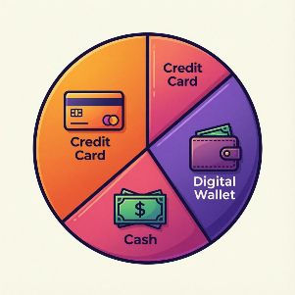
SQL Insights: Trends & Preferences
Monthly Revenue Trend
Payment Preference
Changes in revenue over time.
Most preferred payment methods.

Slide 7

SQL Insights: Value & Demand
Average Transaction Value
Category Demand
Amount spent per customer transaction.
Product category with highest customer demand.

Slide 8


SQL Insights: Regional Spending & Top Products
Regional Spending Pattern
Category-wise Top Products
Regions with higher spending per order.
Best-performing products within each category.

Slide 9

Power BI Dashboard
Visualizing key insights for actionable business decisions.

Slide 10




Key Takeaways
Revenue Growth
Customer Behavior
Strategic Insights
Identified key drivers.
Understood preferences.
Informed decision-making.

